Slide 1
CDE Advisor
Through a Machine Learning approach
Prepared by Muhammad Zariff Wafiy

Slide 2
Content Overview
1.
2.
3.
4.
5.
6.
7.
8.
9.
10.
11.
12.
13.
03
06
07
08
09
11
12
13
15
16
17
18
19
Introduction
Background
Personas
Business Pain Points
Current Improvements
Objectives
Flow Diagram
Possible Solution
User Testing
Project Timeline
Team
Criteria of Data
References

Slide 3
Introduction
Overview
According to Petronas Data Governance Framework, Data Steward is responsible to govern Data Quality within their business.
Data Quality operationalization is via profiling of Critical Data Elements (CDE) of data elements contained within data dictionary/technical metadata.
Default method for CDE classification is to have data analysts refer to data standards and have a discussion with business.
3

Slide 4
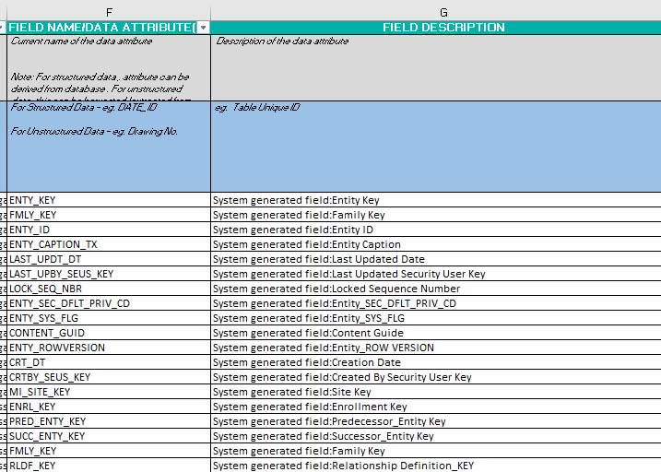
Background
Discussion with business and manual input
Eyeball data elements inside data standard
Compare with technical metadata
Sample of Data Dictionary

Slide 5
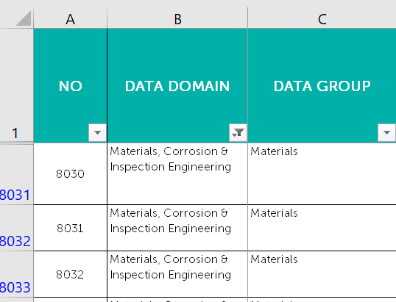
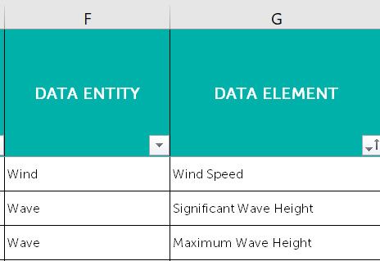
Background
Data standard (Data Entity & Data Element)
Data Standard (Data Domain & Data Group)
*data domain, data category is identified by discussion with business

Slide 6
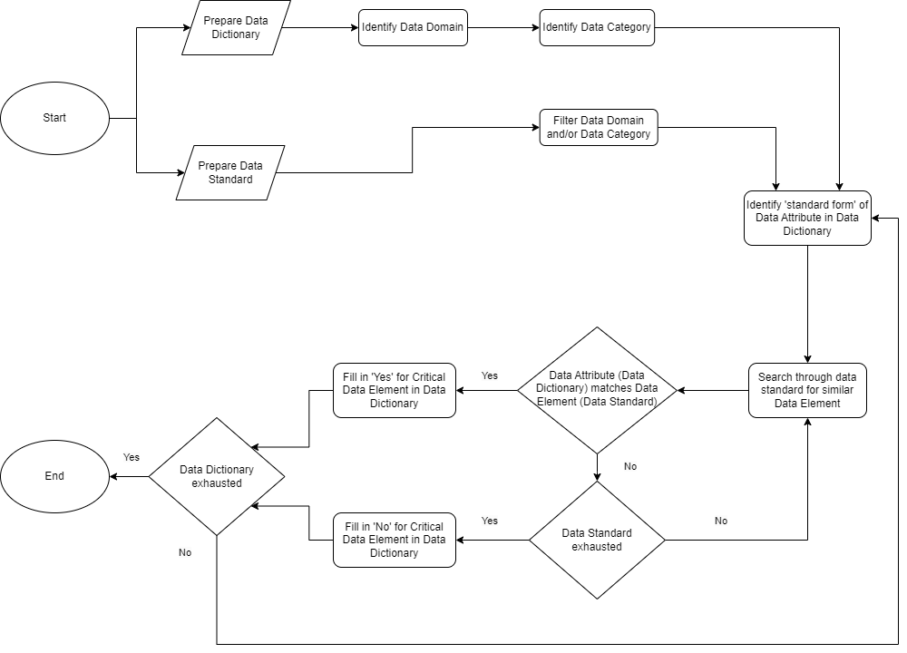
CDE
Classification
Process
Pain Point 1
Pain Point 2

Slide 7


Business Pain Points
Pain Point 1
Attributes in short form & hard to match in data standard
Inaccuracy of identifying matching data element
Guesses / estimation
Prone to Human error
Pain Point 2
High volume of attributes for manual matching
Takes a lot of time
Inefficiency of classifying critical data elements

Slide 8
Persona
Facts
Pains
Persona type:
Data Analyst
Facts
Pains
Facts 1
Facts 2
Pains 1
Pains 2
Manual work to do data validation
Negotiating business requirements
Manual lookup of Data Standards for CDE classification
Train machine learning models in Azure Form Recognizer
Liaise with business stakeholders to gather business requirement
Liaise with technical team (ML engineer & ETL engineer) to build data pipeline
Validate data pipeline
Develop data dictionary
Role: Data Analyst
M Jauzi Abu Hamid
Data Delivery
Worked as a data analyst for NEBULA for unstructured data enablement
Previously worked as Marketing Data Analyst for MoneyLion
Behaviours
Goals
Behaviours
Goals
Takes frequent guesses and estimation to determine the CDE status
Often review data standard and eyeball each rows to match attributes in technical metadata
To have a possible recommendation system for CDE
To have a possible automated validation process for data pipeline
Behaviours 1
Behaviours 2
Goals 1
Goals 2
“I want to make manual tasks easier through possible automation”

Slide 9
Current Improvements
Fuzzy Matching
By comparing Technical Metadata and Data Standard
Macro Logic
Developed a macro using VLOOKUP functions
To search similarities in data standard

Slide 10
Current Improvements
Fuzzy Matching
By comparing Technical Metadata and Data Standard
Macro Logic
Developed a macro using VLOOKUP functions
To search similarities in data standard
Rigidity in VLOOKUP makes it intolerable to short forms in data attributes. Must provide key words.
Does not consider semantic meaning.

Slide 11
Objectives
To understand and document the pain points faced by analysts in developing data dictionary
To recognize the personas (data analysts) and personas’ facts, pains, behaviors, and goals
To design possible solutions to solve the CDE pain points
1
2
3

Slide 12
Flow Diagram
Data Dictionary
Model
Data Standard
Pass necessary attributes regarding a data element as input
Search data standard that is similar to input
Technical metadata/ List of attributes regarding data elements
Recommendation system (NLP/Cosine Similarity)
List of compiled data standards
Provide a list of recommendation as output
Passes a rows of data standards that matches/ similar to input

Slide 13
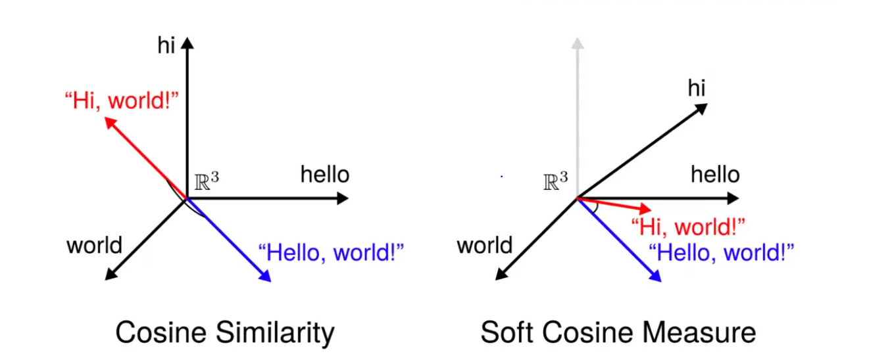
Possible solution
Cosine similarity – identifies similarity between 2 vectors
Word embeddings (Word2Vec / GloVe)
Cosine Similarity
Content-based filtering
Cosine similarity is helpful in determining, how similar the data objects are. In cosine similarity, data objects in a dataset are treated as a vector.
Soft cosine similarity is similar to cosine similarity but in addition considers the semantic relationship between the words through its vector representation.
13

Slide 14

Possible solution
Generative AI – utilize Large Language Models to compare between word pools
Determine a GPT-Model
Tokenization
Input Generation (prompt)
GPT-3 is a versatile language model capable of handling a wide range of natural language understanding and generation tasks. Its ability to compare words from two pools depends on the clarity of the input prompt and the quality of the training data it has been exposed to.
14

Slide 15
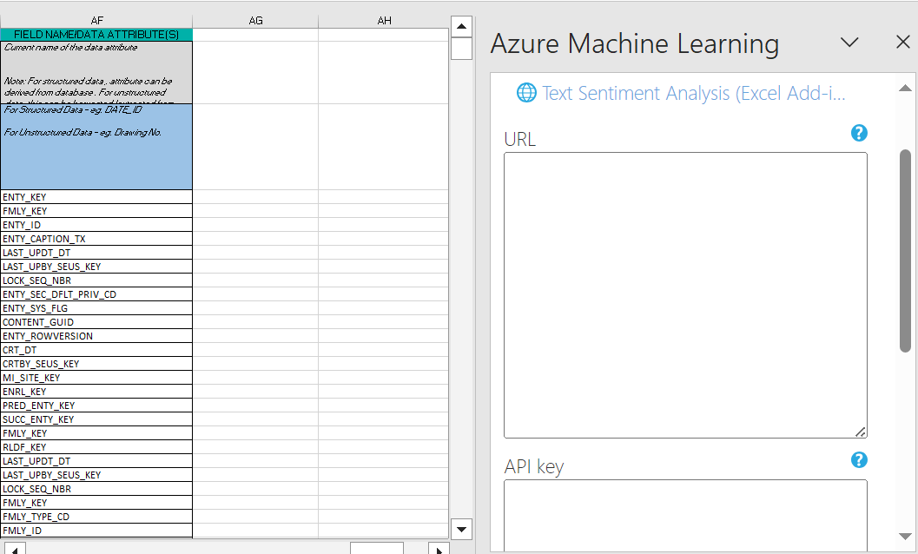
API usage
User Testing
Paste URL / link of API from Azure Machine Learning
Provide API key provided by Azure Machine Learning

Slide 16
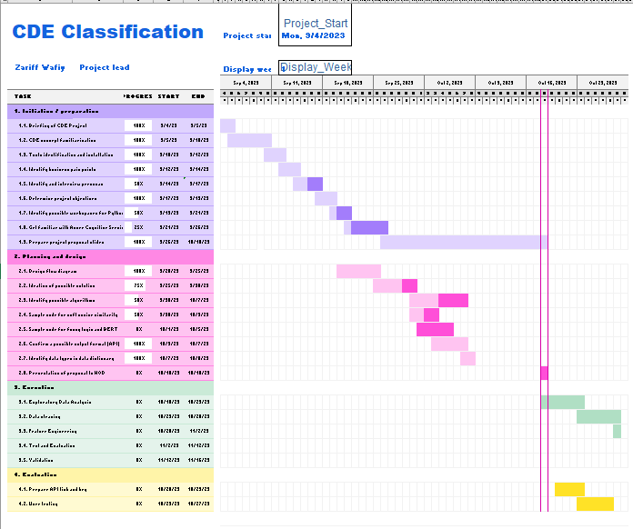
Project Timeline

Slide 17
Team
Supervisor
Asni Mazura Ali
CDE Classification
Improvement
Project Lead
Ilmi Nadhrah Katiman
Project Manager/ Data Scientist
M Zariff Wafiy
Persona (Data Analysts)
Jauzi / other analysts
Advisor (Data Science)
Nik Emir Arif

Slide 18
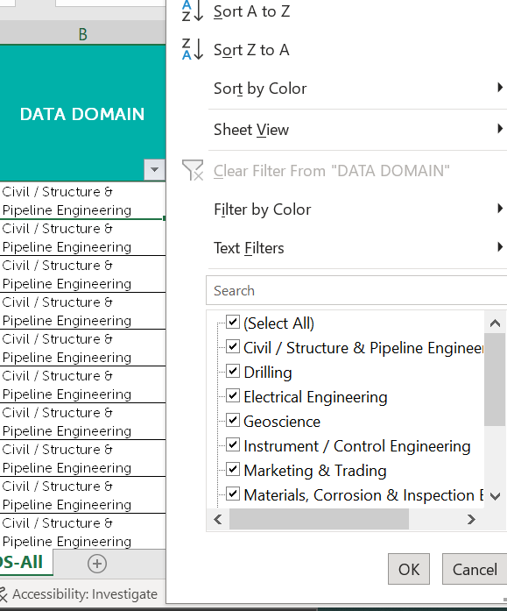
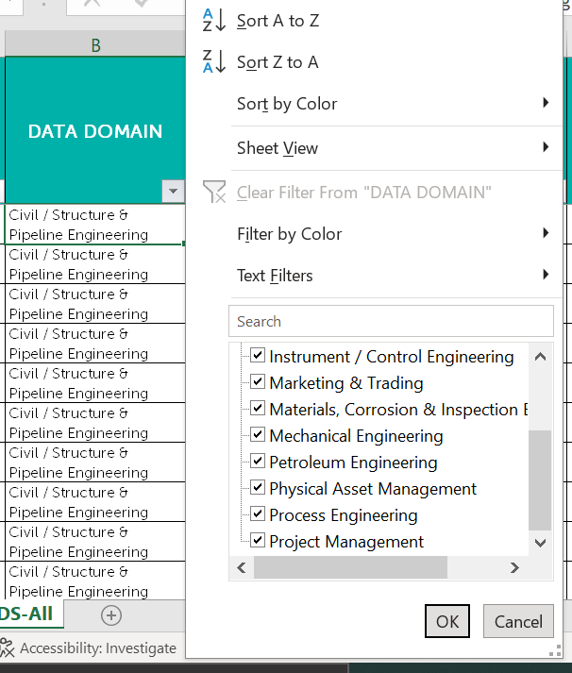
Criteria of Data
Data Dictionary
Data domain need to be within data standard (13 domains )
18

Slide 19
References
Future Internet | Free Full-Text | Hybridizing Fuzzy String Matching and Machine Learning for Improved Ontology Alignment (mdpi.com)
Cosine Similarity Python
Cosine Similarity Concept
(PDF) Semantic Matching (researchgate.net)
19

Slide 20
PETRONAS Passionate about Progress
20

Slide 22
CDE Advisor – 15/12 update
Optimization for better efficiency
Prepared by Muhammad Zariff Wafiy

Slide 23

Optimization 1 - Added Justification
Increases semantic similarity score

Slide 24
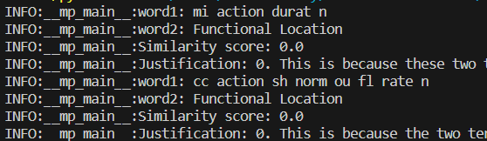
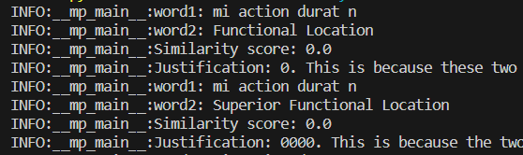
Optimization 2 – Batch processing (parallel processing)
1
1
2
2
Parallel processing
Sequential processing
2 string matching of difference attribute run at the same time.
1 string matching running at a time
Est time (2 attributes):
6 mins
Est time (2 attributes): 12 mins
Parameters :
- Batch size
- Max workers

Slide 25

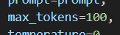
Challenges
Increase in number of tokens produced over time
Reached max limit of tokens generated in a response easier

